Slide 1
MS OFFICE
By Anushree Vasisth.

Slide 2

What is MS OFFICE ?
Bill Gates is the owner of Microsoft company.
Microsoft is a company / corporation in USA.
Notes:
Microsoft is a company / corporation in USA.
Bill Gates is the owner of Microsoft company.

Slide 3
Microsoft office is used for special purpose office work such as:
What is Microsoft office?
Documentation
Work sheet
Presentation
Data base.

Slide 4
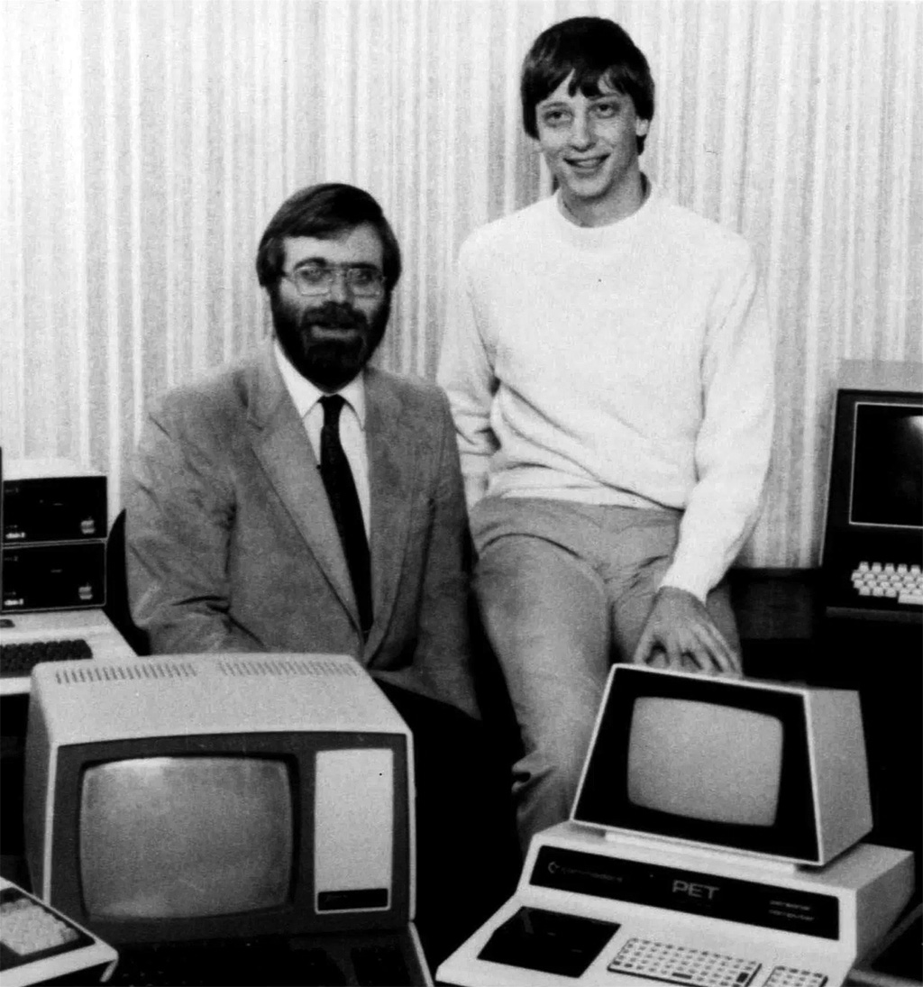
A LITTLE HISTORY …..
40 years ago , on April 1975 , Bill Gates and Paul Allen, friends from Lakeside school in Seattle, formed a little partnership . Gates was 19 and Allen 22 . That partnership was called MICROSOFT.
The 40 years long journey saw Microsoft evolving into one of the world’s largest technology companies and is marked with numerous milestones.
This Photo by Unknown Author is licensed under CC BY-NC-ND

Slide 5
KEY MILESTONES IN THE HISTORY OF MICROSOFT OFFICE.
1988:
Microsoft office was announced by Bill Gates at COMDEX in Las Vegas , bundling Word , Excel and PowerPoint for the first time.
1990:
The version of Microsoft office for windows was released , containing Word 1.1 , Excel 2.0 and PowerPoint 2.0.
1990s :
Microsoft office expanded its offering with the introduction of outlook, Access and other applications.

Slide 6
2003:
Introduced XML-based document formats for Word documents.
2007:
The fluent user interface ( also known as the Ribbon) was introduced with office 2007.
2010
Introduced the first 64-bit version of office and also provided free online versions of core apps.
2013
Introduced a cleaner interface , new pricing models and integration with SKYDRIVE.
Notes:
2003:
Introduced XML-based document formats for Word documents.
2007:
The fluent user interface ( also known as the Ribbon) was introduced with office 2007.
2010
Introduced the first 64-bit version of office and also provided free online versions of core apps.
2013
Introduced a cleaner interface , new pricing models and integration with SKYDRIVE.
2013: Introduced a cleaner interface , new pricing model and integration with SKYDRIVE.

Slide 7
MICROSOFT OFFICE
A package of software or a suite of products developed by Microsoft Corporation that includes .
WORD – text editor
EXCEL - spreadsheet
POWERPOINT – presentations
OUTLOOK – email
ACCESS – database
Publisher – brochures, calendars , postcards etc.
The current version is Microsoft office 2019 which was released on September 24,2018. Succeeding office 2016 & office 365.

Slide 8
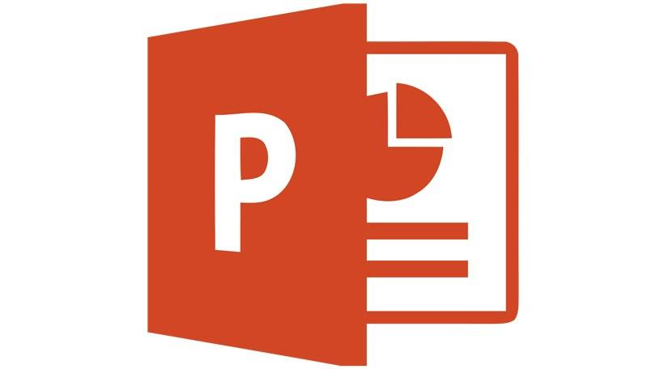

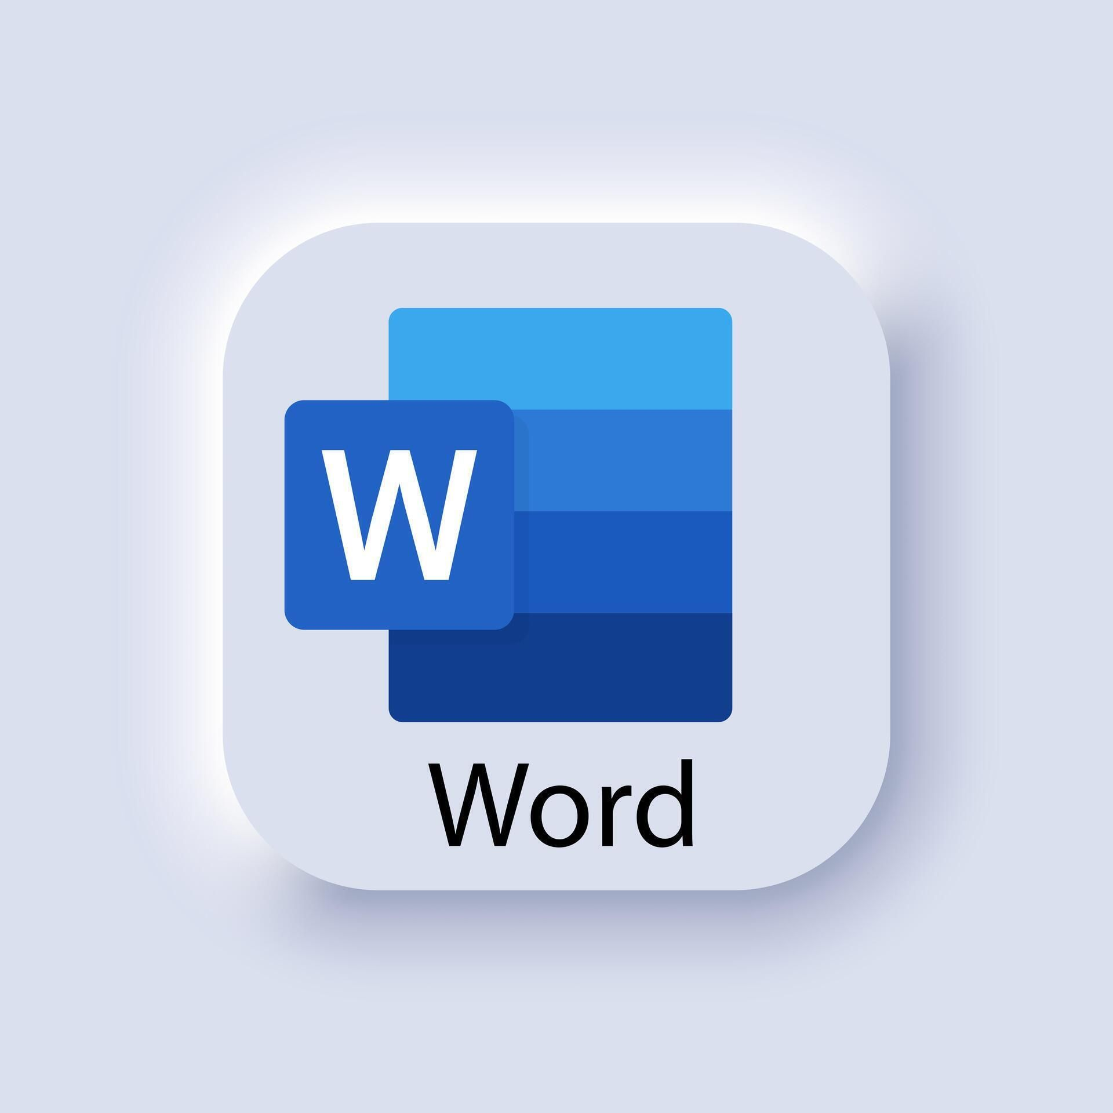

MS-OFFICE HAS FOUR PACKAGE
Notes:
MS-OFFICE HAS FOUR PACKAGE

Slide 9
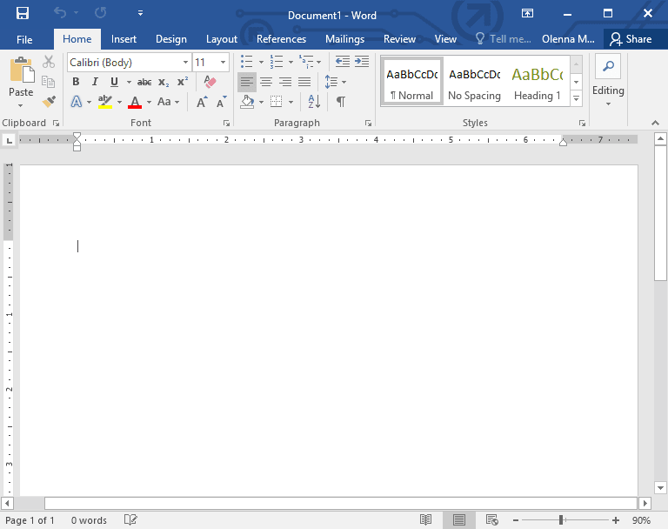
MICROSOFT WORD

Slide 10
MICROSOFT WORD
Text processor to create documents.
Templates for different types of documents .
Web pages.
Microsoft word or MS WORD (often called word) is a graphical word processing program that users can type with. It is made by the computer company Microsoft . The purpose of the MS.
Word is to allow the users to type and save documents. Similar to other word processors, it has helpful tools to make documents.
SIMPLE FORMATTING
Text : Font , size , colour, bold/italic/underline
Layout : Bullets , numbering , alignment.

Slide 11
FEATURES OF MICROSOFT WORD
Creating Document
Editing document
Graphics
Word Art
Printing Document

Slide 12
PROOFING WORD DOCUMENT
Spelling Checker
Grammer checker
Thesaurus
Auto correct

Slide 13
USES OF MICROSOFT WORD
With this application , we can check for grammar and spelling error. We can also get visual edge through text modifications.
With the WordArt feature , we can choose a compelling design that can match the theme . Beside the WordArt feature , we can also modify the visual look of our text the way we want to.
Sending letters.
News Articles.
Scholarly Documents.
Envelopes.
Blog posts.
Homework and assignments.
Publishing of Books.
Compelling Documents.

Slide 14
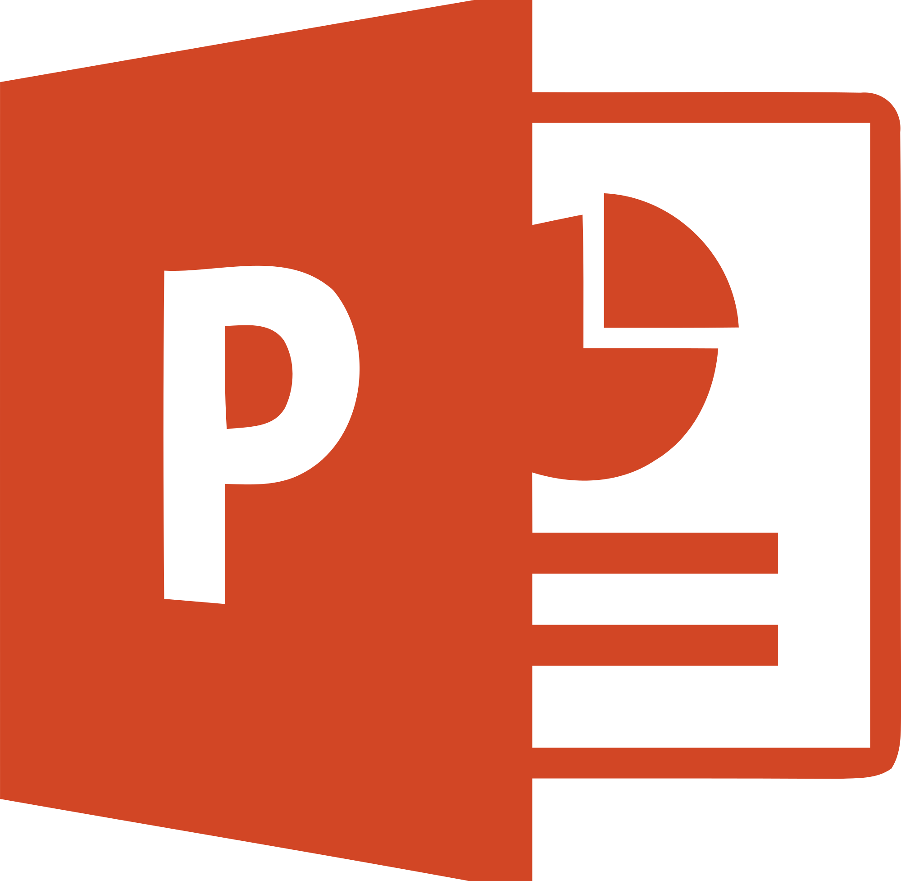
MICROSOFT POWERPOINT

Slide 15
MICROSOFT POWERPOINT
Software to make presentations.
Templates and different designs.
Same menus as Microsoft Word.
Power point is a complete presentations graphics package . It gives you everything you need to produce a professional-looking presentations . PowerPoint offers word processing , outlining, drawing, graphing and presentation management tools– all designed to be easy to use and learn.

Slide 16
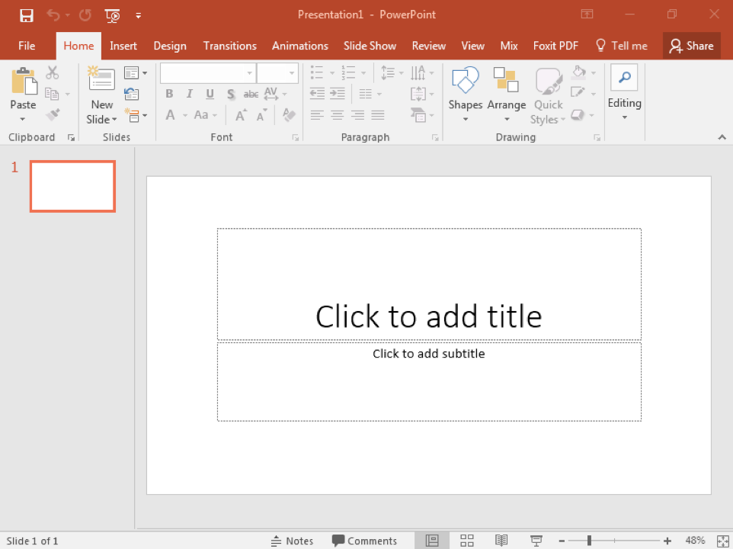
MICROSOFT POWERPOINT

Slide 17
FEATURES OF MS-POWERPOINT ?
Power point is computer software created by Microsoft which allows the users to create slides with recordings, narrations, transitions and other features in order to present information . An example of POWERPOINT is presentation software made by Microsoft.

Slide 18
HOW TO MAKE A NICE PRESENTATION.
Text.
Font should be easy to read.
Text colour with high contrast to the background.
Big font size.
Less text is better.
Use the same formatting throughout the presentation.
Pictures and figures.
Choose understandable figures.
Pictures with high quality.
Pictures and figures should be relevant.

Slide 19
PRESENTATION TIPS
Be careful with use of animations.
Know what you are presenting.
Don’t read from the slide.
Speak to the people.
Speak loudly.
Practice before presentation.

Slide 20

MICROSOFT EXCEL

Slide 21
MICROSOFT EXCEL
Microsoft Excel is a spreadsheet application developed by Microsoft for Microsoft windows, mac OS X , and IOS . It features calculation, graphing tools , pivot tables and a macro programming language called Visual Basic for applications .
ALSO KNOW AS & FOR :
Mathematical software
Spreadsheets to make statistical calculations
Formula for calculations of different results in a set of data.
In & out data
Graphical view of statistics.

Slide 22
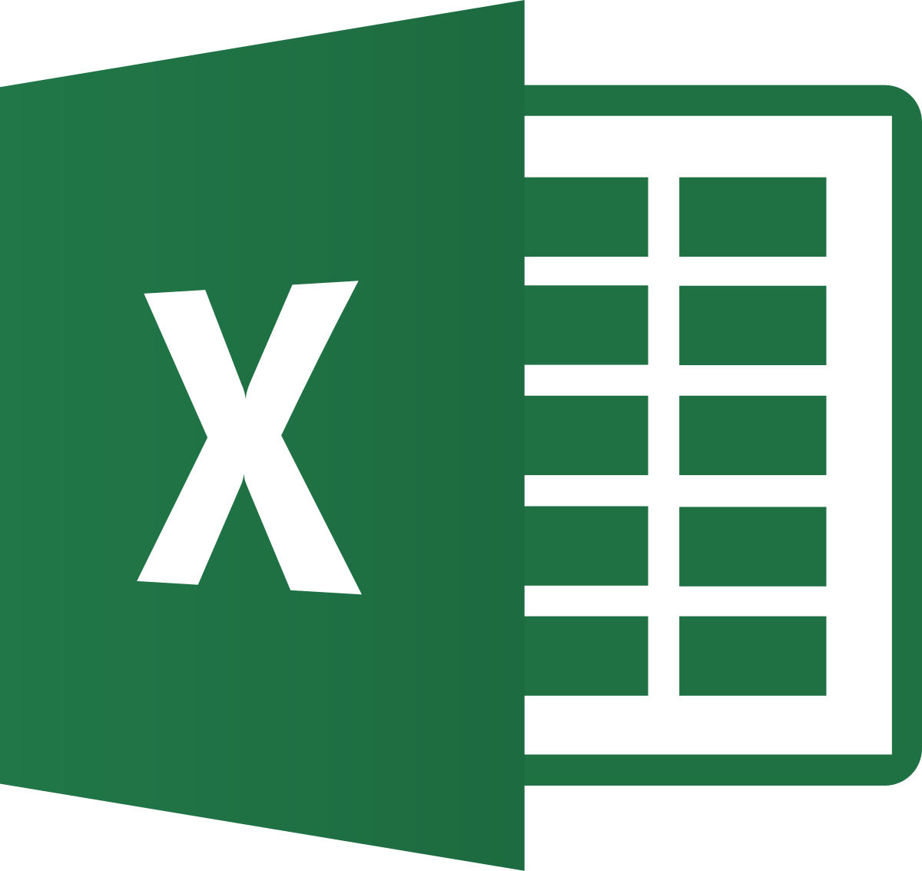
USES OF MICROSOFT EXCEL
HELP IDENTIFY TRENDS
Excel allows trends lines to be extended beyond the graph , to offer predictions of future activity – and such forecasts can help businesses develop their future strategy.
BRING DATA TOGETHER
Excel can be used to bring information from various files and document together , so that it exists in a single location . As well as raw data and information from other spreadsheet , it is possible to import text and images. Other objects can be added using the insert tab, or additional spreadsheet can be added to this file.

Slide 23
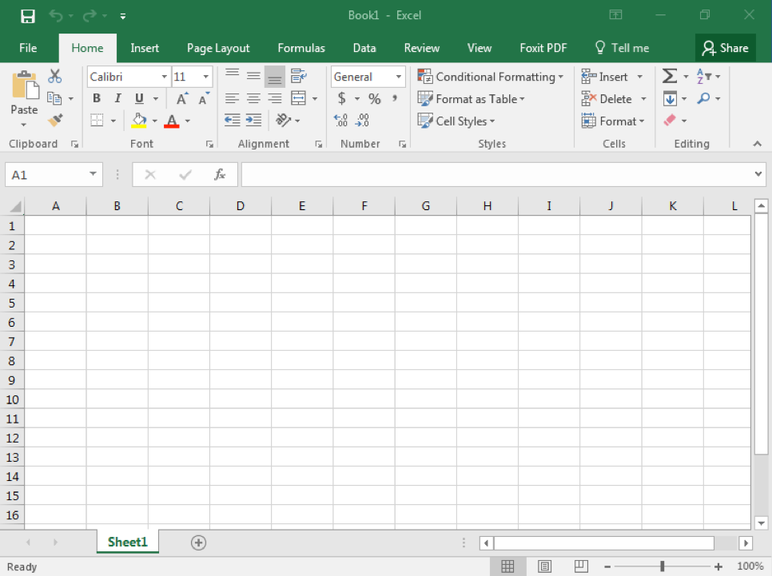
MICROSOFT EXCEL

Slide 24
Table of contents
Getting started
The new interface
Excel basics

Slide 25
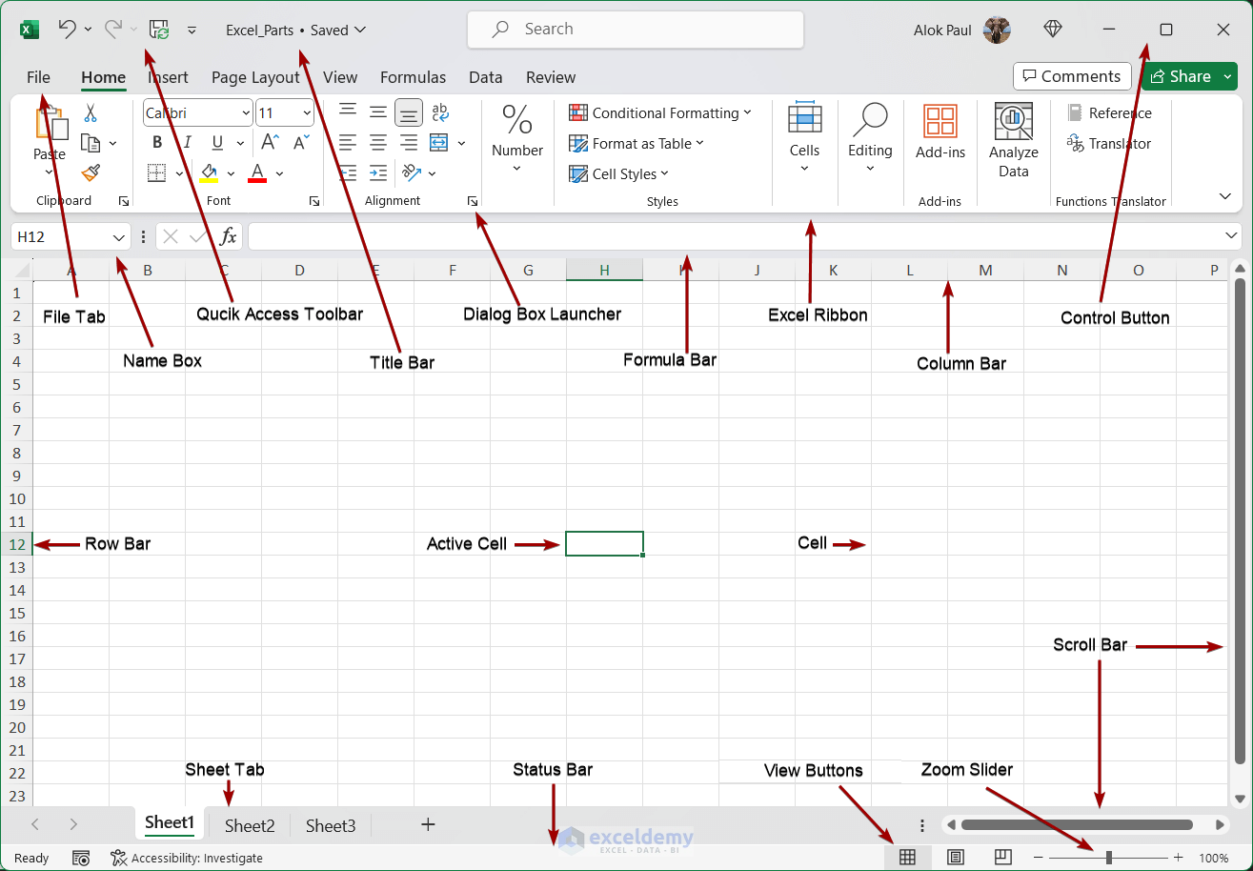
COMPONENTS OF EXCEL.

Slide 26
FEATURES OF MS EXCEL.
Excel is an Microsoft Application that is mainly use for calculations and mathematical works.
IT is a spreadsheet application in which we can add sheets as per our requirements . In a single sheet , it consists of rows and columns and cells , where every cell has different address.
Sum , product , subtraction, division and many mathematical , logical functions are available within it.
Other features include tables, charts , clip art and more.
It is basically used for payroll, accounts , mathematical , and for other business purposes.
HYPERLINK : we can link one file to another file or page.

Slide 27
SOME FUNCTIONS OF MS-EXCEL.
Average
Count
Pi
Sum
Product
Max
If
Notes:
Average
Count
Pi
Sum
Product
Max
If

Slide 28

MICROSOFT ACCESS.

Slide 29
What is MS-ACCESS?
MS-ACCESS is a tool which used for create database and it is also a application software.

Slide 30
FEATURES OF MS-ACCESS.
Primary
Record
Field
Table
Form
Report
Primary key

Slide 31
USES OF MICROSOFT ACCESS.
DATA STORAGE AND ORGANIZATIONS.
DATA ANALYSIS AND REPORTING.
AUTOMATION AND CUSTOMIZATION.
LINKING TO EXTERNAL DATA.

Slide 32
CONCLUSION
Simply.
MS WORD used for to write documents.
MS EXCEL used for to make spreadsheet.
MS PowerPoint for presentations.
MS access for data base management purpose.

